Slide 1


Adapting foundational teaching skills to third level education
Romina Maddalena

Slide 2
The students
Age: 19 years old
Japan
10 weeks: English and Law course
English: Intermediate level
Japanese educational system is considered to
be one of the bests in the world
Classroom culture: very different from occidental ways of learning
Characteristics of the group: diligent, responsible, good performers in individual tasks, they are afraid of being wrong, they don't like being corrected.
This may be reflected on: participation, asking questions.

Slide 3
Learning english, my experience
I've studied English for 15 years
Language barrier is an aspect not to be underestimated
Two big aspects that may affect their learning, due to the characteristics of the group
Not making mistakes is almost impossible
Speaking in front of natives or advanced
speakers can be very embarrassing
I will help if I am needed, but it will not be my position to correct their English. I will not be focusing on that, the language will be the tool that we both have to communicate between us
Base my speech on plain language: use basic structured sentences s + v + o
Avoid using legalese, inversions, complex structured sentences

Slide 4
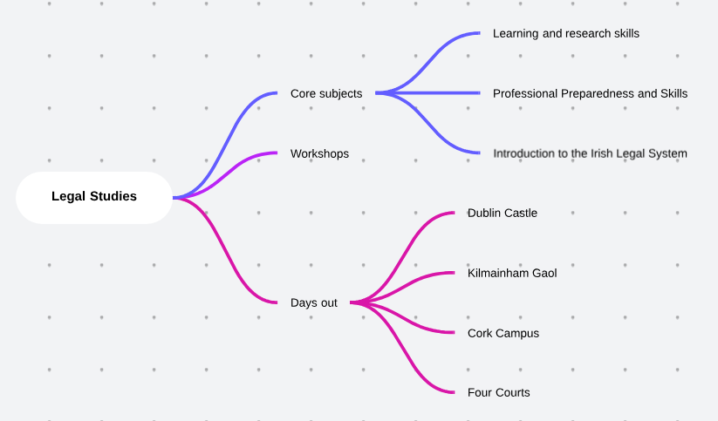
The programme:
legal studies
Final Project
Learning and research skills:
Base module
Comprised in the first two weeks

Slide 5
The module: learning and research skills
Approaches to Learning and Self-motivation
Effective note taking and study skills
Referencing and citations
Using the Library and Online "Remote Access" resources
Developing project portfolio
Analytical reading and critical analysis
Verbal and written communication
Academic writing
Preparing for and presenting effectively
Planning essay and problem solving
Different group configurations
Individual tasks
Online resources
Kahoot!
Videos

Slide 6
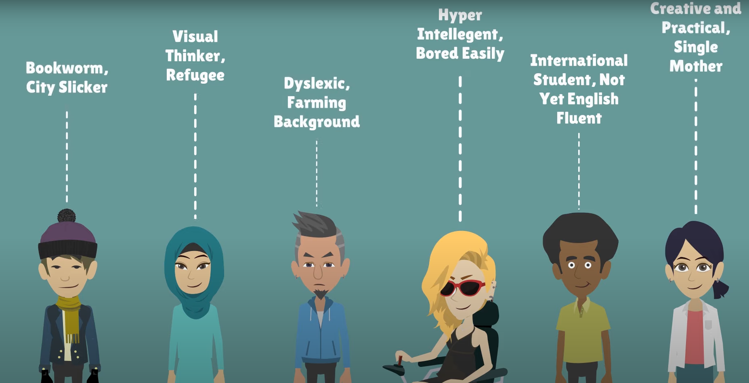
universal DESIGN for learning
CAST (nonprofit research organization)
Philosophy: tight goals, flexible means
Provides guidelines to adapt our classes to all different ways of learning
What is Universal Design for Learning (UDL)? - AHEAD
https://www.youtube.com/watch?v=AGQ_7K35ysA&t=40s

Slide 7
universal DESIGN for learning
CAST (nonprofit research organization)
Provide multiple means of:
Engagement (why?): for students to feel motivated to participate, stimulate to keep them interested
Representation (what?): using multiples formats and media, present content in different ways
Action & expression (how?): multiple pathways for students' action and demonstration of what they know

Slide 8

EVALUATION
Requirements:
Personal feedback
Engagement (with learning and with other Faculty learners)
Progression
Involved and immersed in the Faculty events

Slide 9
EVALUATION
SUMMATIVE
Assessment of learning
Occurs after the instruction is complete
Evaluates how well the instruction worked in the past
Covers larger instructional units of study such as a full semester or a year
Often uses quantitative (numerical) data to apply formal measurement and evaluation techniques to determine outcomes
FORMATIVE
Assessments for learning
Occurs frequently throughout instruction
Informs ongoing instruction to improve student learning outcomes in real time
Usually covers discrete content (e.g., one skill or concept)
Often uses qualitative (descriptive) data to evaluate a current state based on informal measurement

Slide 10
EVALUATION
Requirements:​
​
Personal feedback​
Engagement (with learning and with other Faculty learners)​
Progression​
Involved and immersed in the Faculty events
Ideal opportunity to choose a formative evaluation
Reflection of their experience​
Their own point of view​
Instant feedback for lecturers​
Possibility to share with others (or not)​
Reflect their interests for future experiences

Slide 11
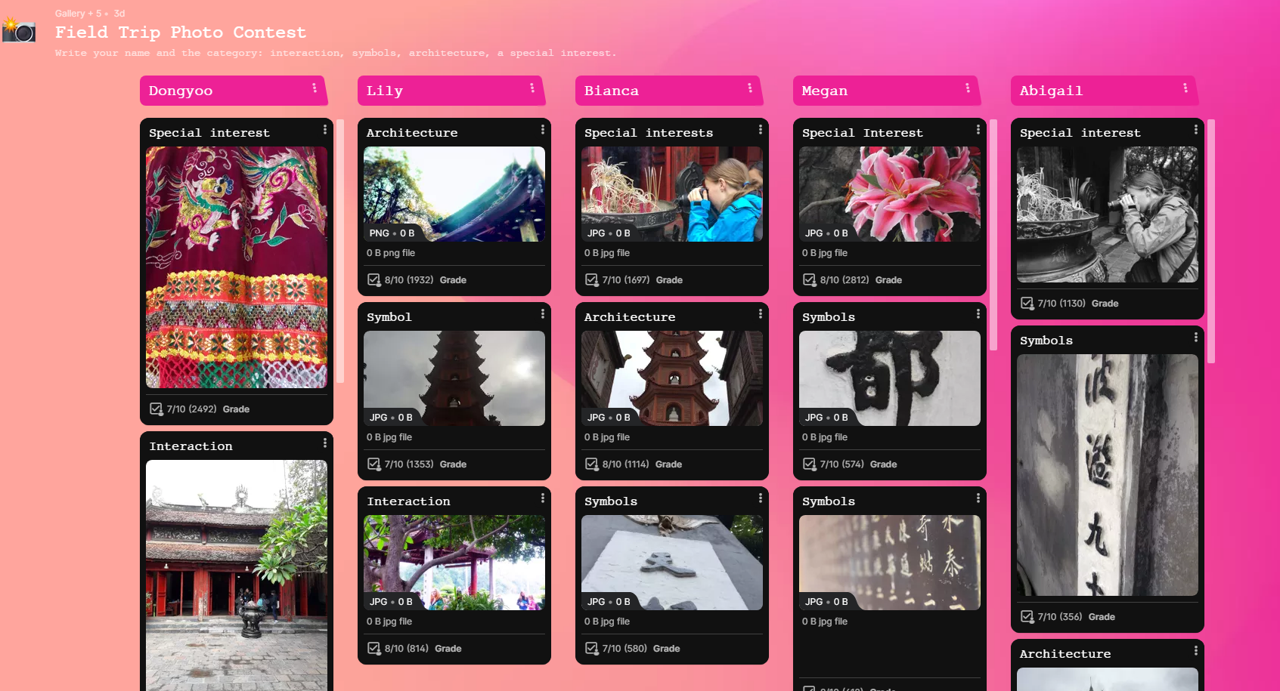
PADLET
Interactive board where they can keep track of their experience at Griffith College using interactive tools (pictures, texts, videos, links, mindmaps, etc.)

Slide 12
THANK YOU
Romina Maddalena
romina.maddalena@griffith.ie

