Slide 1

Diversifying Dewey: Changing the DDC23 to better represent Irish Travellers
Dean Watters & Ruth O'Hara

Slide 2
Why
Gaelic Games
EDI
Irish Travellers, also known as Mincéirí or Pavees, are an indigenous ethnic minority community based primarily in Ireland and Great Britain. Throughout their history, Irish Travellers have been segregated from the general Irish population. This has resulted in widespread discrimination, and a lasting stereotyping that endures to this day…. The current treatment for Irish Travellers in DDC 23 is somewhat reflective of this in that works are frequently misclassified… Irish Travellers are not explicitly mentioned in the current DDC

Slide 3
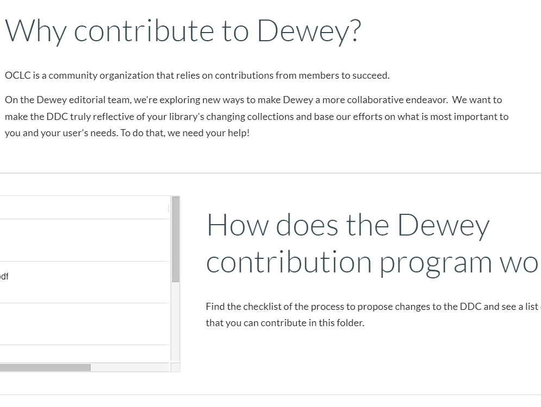
Preparing the Exhibit
DDC Editorial Policy Committee
OCLC Resources
Exhibit Template

Slide 4
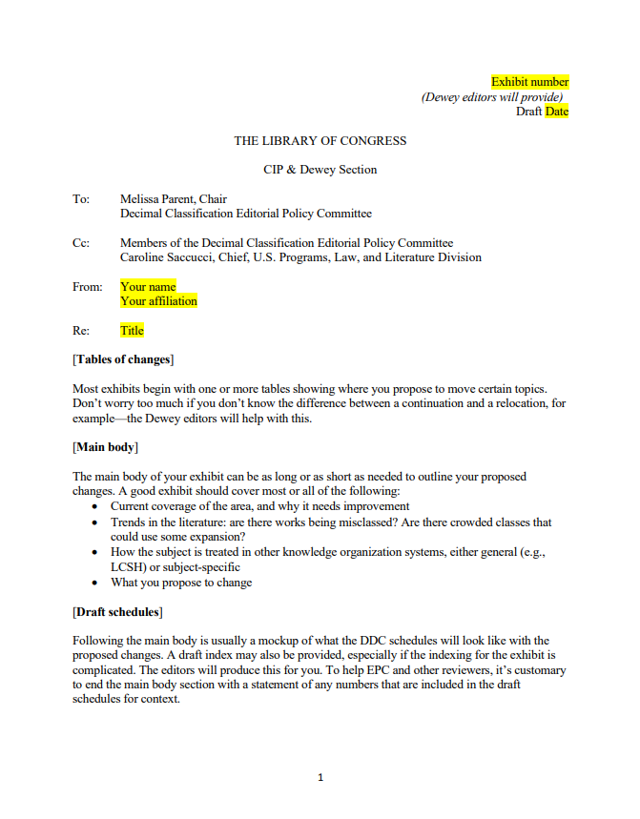

Slide 5
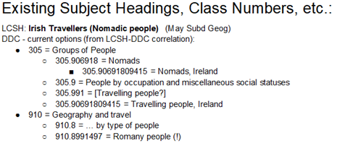

Current Classification –v- New Recommendation

Slide 6
Working with OCLC
•Key issues primarily based on terminology
•Pavees, Shelta/Cant/Gammon
•Irish translation?
•Drafting the exhibit into “Dewey-ese”

Slide 7
Working with LAI CMG Colleagues
Reporting back
Getting advice particularly on terminology
Recommendations of who to contact in the Travelling Community

Slide 8
Working with the Traveller Community
Engage with as many experts on the topic as possible
Multidisciplinary approach
Fine tuning the final exhibit

Slide 9
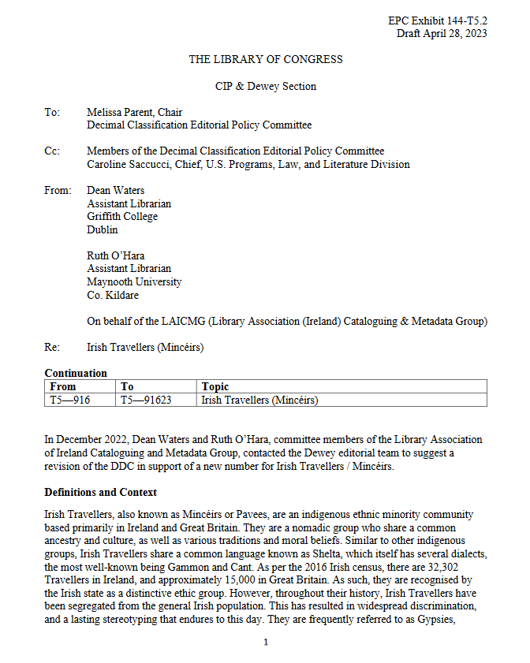
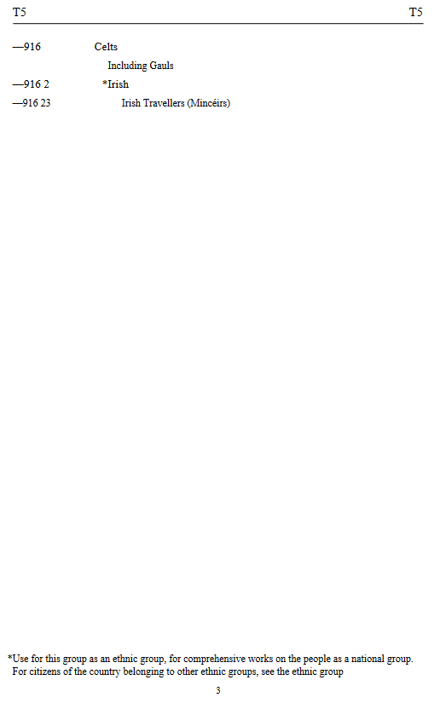

Slide 10
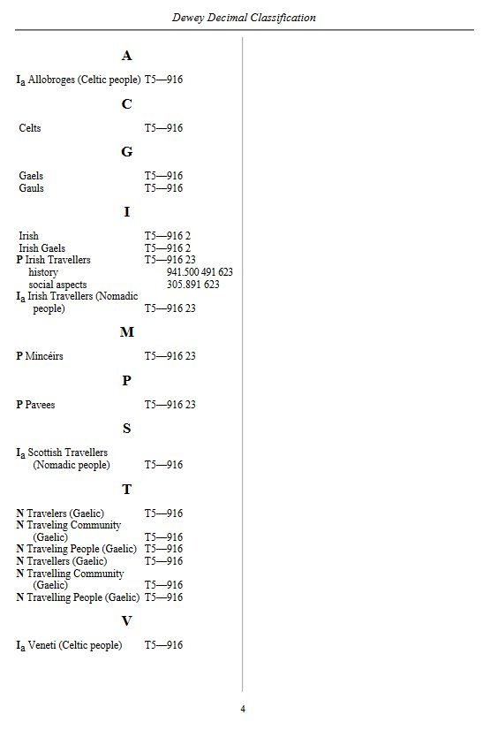

Slide 11
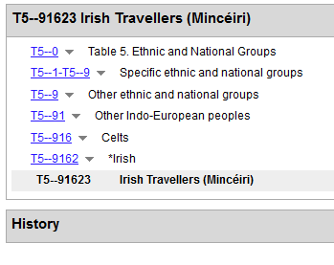
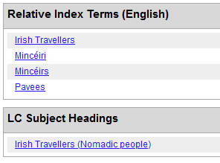

Slide 12
Resources
Resources for Contributing an Exhibit
Blog Post on LAI CMG Wordpress

